Slide 1
UiPath Hackathon Covid Travel Advisor
Team Name: Roboyo Bots Team
Notes:
Joe 1-3

Slide 2




Roboyo Bots
Emiliano Lowe
Thomas Mitchell
Joseph Hogan
Michael Gladstein
Managed Services Engineer
Emiliano.Lowe@Roboyo.de
Senior Automation Engineer
Thomas.Mitchell@Roboyo.de
Senior Consultant
Joseph.Hogan@Roboyo.de
Solution Architect
Michael.Gladstein@Roboyo.de
Notes:
Joe 1-3

Slide 3

Problem Statement
International Travel During Covid 19
International travel during Covid can be difficult as every country has different requirements, forms, tests, and quarantine periods. As an international company, Roboyo employees, often travel and find it difficult to navigate the covid requirements.
Potential Requirements include:
Covid 19 Test predeparture
Entry restrictions based on vaccination status
Quarantine periods
Mask mandates
EU Health pass
Proof of vaccination status
Health screenings
Other possible restrictions
As every country has different requirements, it is easy to see how something could be forgotten or missed. This could result in delay or cancelled travel plans.
Notes:
Joe 1-3

Slide 4

Benefits
Covid Travel Advisor App
The Covid Travel Advisor App allows users to enter the origin and destinations along with the vaccination status of the traveler and outputs a convenient emailed checklist for all locations along the journey.
View and organize all requirements for each destination in a summarized email
No more worrying about inaccurate information! The website used in the automation is trusted by travel industry leaders like American Airlines.
Reduce the risk of delays or cancellations from missed or forgotten requirements
Notes:
Nano 4-5

Slide 5
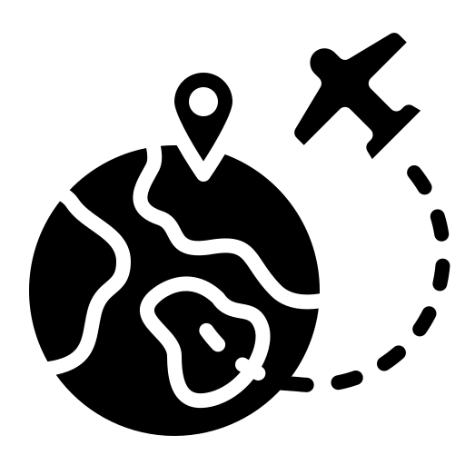
Solution Overview
Details
End-User | International Travelers
User Department | All
Industries | All
UiPath Products Used | UiPath Studio UiPath Apps UiPath Data Services
Other – Integrations / APIs / Technologies Used | Sherpa Website
Project Stage: Implemented
Notes:
Nano 4-5
Details: Its always good to share details like who is the end-user of your solution, which department/industry will benefit and what technologies have been used.
Benefits: Please include key features / value proposition of your solution
Project Stage: It will be great to mention your project stage

Slide 6




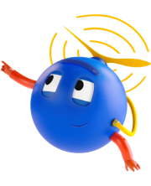

Technologies Used
 |  | UiPath Data Services
UiPath Studio manages the process to scrape, manipulate, and push data to UiPath Apps and Data Services | UiPath Apps was leveraged to create a user interface for easy interaction with the automated processes designed in studio. | UiPath Data Services stores the data that was scraped from a webpage for each destination on the journey
Notes:
Michael G. 6-7

Slide 7
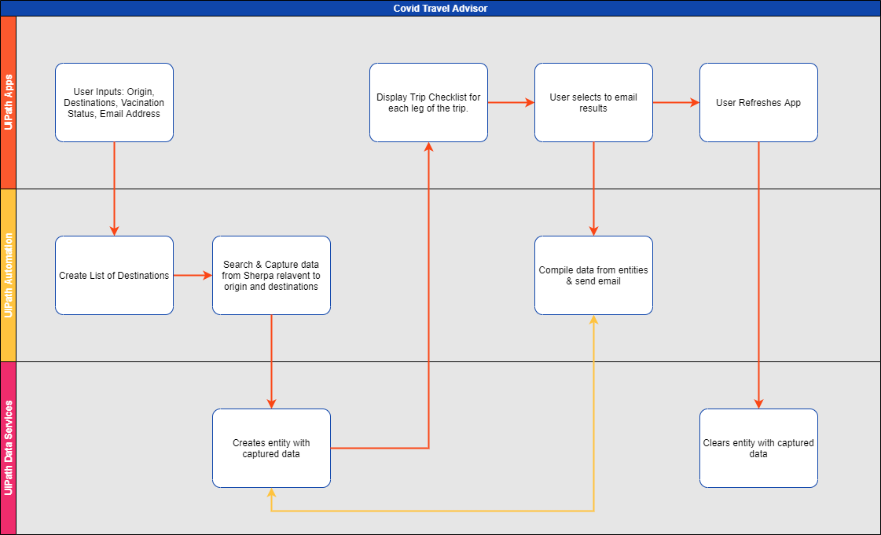
Notes:
Michael G. 6-7

Slide 8
Live Demo
Notes:
Thomas Live Demo

Slide 9
Appendix
Deployment
UiPath Studio:
- Upload Process Packages to Orchestrator and create processes (.nupkg files)
UiPath DataServices:
- Import Schema to DataServices:TripSummarySchema_Dataservices.json
UiPath Apps:
- Create new UiPath App and Import file CovidTripAdvisor-UiPathHackathon2021.uiapp

